Slide 1


Lecture1 C++ Basics
PROGRAMMING 1
(CS 102)
1
Fall (2025-2026)

Slide 2

Course description
This course The course presents the fundamental concepts of programming and algorithmic problem solving, primitive data types, control structures, functions and parameter passing, top-down design, arrays, files, and the mechanics of compiling, running, testing, and debugging programs.

Slide 3
Course Learning Objectives
Explain and define fundamental programming concepts, including variables, data types, the sequential nature of program execution, and basic program input/output (I/O).
Trace and debug simple programs to identify and correct basic syntax and logical errors.
Apply basic programing concepts, such as conditional statements, loops, and functions, to solve small scale computational problems.
Decompose problems into smaller, manageable subroutines, and implement basic functions to enhance code modularity and reusability.
Collaborate with peers Work in a team to design and implement a software project that meets specific functional requirements.

Slide 4

Assessment Strategy
Grading:
Course work (Quizzes - Activates ) | 10 %
Practical(Course Project - Labs) | 20 %
Midterm Exam | 20 %
Final Exam | 50 %
Midterm Exam | Date : 8-11-2025 to 13-11-2025

Slide 5
COURSE CONTENTS
✅ Lecture 1 – Introduction & Basics
• What is C++, history, compiling, IDEs.
• Structure of a C++ program.
• Input/Output.
✅ Lecture 2 – Variables & Data Types
• Data types (`int`, `float`, `char`, `string`, `bool`).
• Constants.
✅ Lecture 3 – Operators & Expressions
• Arithmetic, relational, logical, increment/decrement.
• Precedence of operators.
✅ Lecture 4 – Control Structures
• `if`, `if-else`, nested `if`.
• `switch-case`.
✅ Lecture 5 – Control Structures
• Loops (`for`, `while`, `do-while`).
✅ Lecture 6-7 – Functions
• Defining & calling functions.
• Function parameters & return values And Scope of variables.
✅ Lecture 8-9 – Arrays
• Single & multi-dimensional arrays.
• Traversing arrays.
• Basic array algorithms.
✅ Lecture 10 – Pointers
• Basics of pointers.
• Pointers with arrays & functions.
✅ Lecture 11 – Object-Oriented Programming
• Classes & objects.
• Constructors, destructors.
• Member functions.
✅ Lecture 12 – Advanced Topics & Projects
• File handling (read/write).
• Small projects.

Slide 6

Lecture 1: C++ Basics
Basic Concepts
Introduction to C++
C++ User Input and Output

Slide 7
1. Basic Concepts
Programming: The process of writing instructions and commands for a computer or any other device, to guide it and inform it of how to deal with data. And the programming process follows specific rules in the language chosen by the programmer.
Programmer: The person who is able to use instructions and commands to solve a problem using a programming language.

Slide 8
Program vs. Algorithm
Program
Is a set of instructions that, when executed, causes the computer to behave in a predetermined manner.
It is written using programming language.
Algorithm
Step-by-step procedure to perform a specific task in a finite time.
It is a step by step procedure to solve the problem.
It is written in pseudo code (a plan or initial draft of the code).

Slide 9

Program vs. Algorithm
Program
A program contains a list of values (called variables) and a list of directions (called statements) that tell the computer what to do with the variables.
The variables can represent numeric data, text, can be organized (structured) in different ways.
Algorithm
In computer science, pseudocode is a plain language description of the steps in an algorithm or another system.
Pseudocode often uses structural conventions of a normal programming language, but is intended for human reading rather than machine reading.

Slide 10
2. Introduction to C++
What is "C++"?
C++ is a cross-platform programming language used to create high-performance applications.
C++ is used to create computer programs, and is one of the most used language in game development.

Slide 11
Why Use C++?
C++ is fun and easy to learn!
C++ is one of the world's most popular programming languages.
C++ can be found in today's operating systems, Graphical User Interfaces, and embedded systems.
C++ is an object-oriented programming language which gives a clear structure to programs and allows code to be reused, lowering development costs.
C++ is portable and can be used to develop applications that can be adapted to multiple platforms.
As C++ is close to C# and Java, it makes it easy for programmers to switch to C++ or vice versa.

Slide 12
C++ Install IDE
An IDE (Integrated Development Environment) is used to edit AND compile the code.
Popular IDE's include Code::Blocks, Eclipse, and Visual Studio code. These are all free, and they can be used to both edit and debug C++ code.
We will use Visual Studio code.
Note: Web-based IDE's can work as well, but functionality is limited.

Slide 13
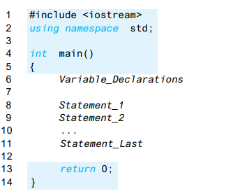
C++ Program Layout
The Typical C++ Layout

Slide 14
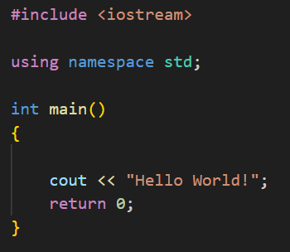
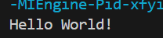
First Example (live coding)
Let's create our first C++ file.
Write the following C++ code and save the file as myfirstprogram.cpp (File > Save File as):
#include <iostream>
using namespace std; int main()
{ cout << "Hello World!";
return 0;
}

Slide 15
Example explained
Line 1: #include <iostream> is a header file library that lets us work with input and output objects, such as cout (used in line 5). Header files add functionality to C++ programs.
Line 2: using namespace std means that we can use names for objects and variables from the standard library.
Line 3: Another thing that always appear in a C++ program, is int main(). This is called a function. Any code inside its curly brackets { } will be executed.
Line 4: Opening curly bracket { to actually start the main function.
Line 5: cout (pronounced "see-out") is a function used together with the insertion operator (<<) to output/print text. In our example it will output "Hello World".
Line 6: return 0 ends the main function.
Line 7: Do not forget to add the closing curly bracket } to actually end the main function.

Slide 16
New Lines
To insert a new line, you can use the \n character:
#include <iostream>
using namespace std;
int main()
{
cout << "Hello World! \n";
cout << "I am learning C++";
return 0;
}
Tip: Two \n characters after each other will create a blank line

Slide 17
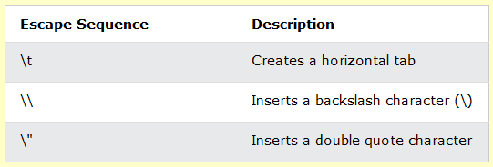
New Lines
Another way to insert a new line, is with the endl manipulator:
#include <iostream>
using namespace std;
int main()
{
cout << "Hello World! "<< endl;
cout << "I am learning C++";
return 0;
}
Examples of other valid escape sequences are:

Slide 18
C++ Comments
Comments can be used to explain C++ code, and to make it more readable.
Single-line Comments
Single-line comments start with two forward slashes (//).
Any text between // and the end of the line is ignored by the compiler (will not be executed).
This example uses a single-line comment before a line of code:
// This is a comment
cout << "Hello World!";

Slide 19
C++ Comments
C++ Multi-line Comments
Multi-line comments start with /* and ends with */.
Any text between /* and */ will be ignored by the compiler:
/* The code below will print the words Hello World! to the screen, and it is amazing */ cout << "Hello World!";

Slide 20
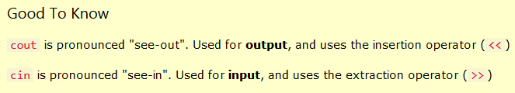
3. C++ User Input and Output
You have already learned that cout is used to output (print) values. Now we will use cin to get user input.
cin is a predefined variable that reads data from the keyboard with the extraction operator (>>).
Example:
int x; cout << "Type a number: "; // Type a number and press enter cin >> x; // Get user input from the keyboard cout << "Your number is: " << x; // Display the input value

Slide 21



